Slide 1
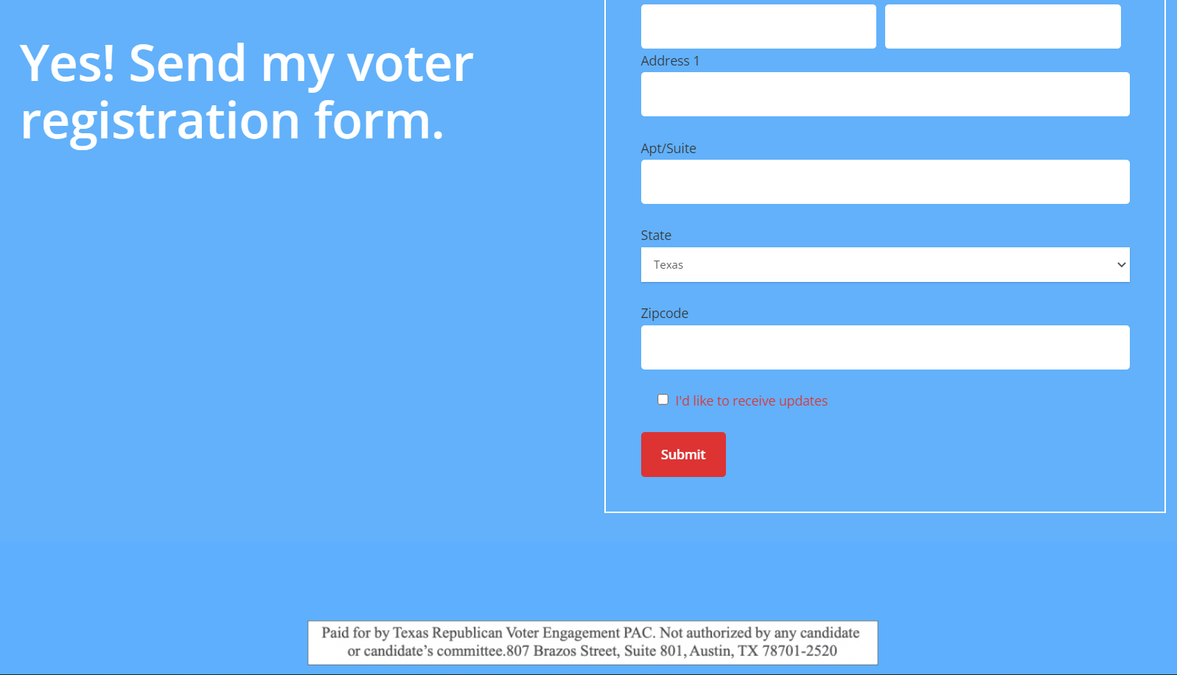
VEP State Training Advantage Reddialer
State Regional Training VEP
Proprietary
Updated 02-21-21 V2.3

Slide 2
Texas Voter Engagement Program (txvoterengagement.com)

Slide 3
Disclaimer
This presentation is for the sole purpose of sharing information internally for RD Training.
This should be kept confidential as it is proprietary information and not shared externally.
This can be shared internally with our Texas Republican Volunteer Engagement PAC VEP team members and volunteers of our efforts.

Slide 4
VEP Texas 2022 Goals
It is the VEP goal we each try to accomplish 200 calls minimum per week to meet a goal of over 100,000 plus new registered voters. (anything 50 or greater a week is great though 200 each week would be awesome)
Try to add 5 new team members a week.
This prepares us for future endeavors as we get closer to the fall and the November election.
Calls to be made between 10 am – 9 pm CST

Slide 5
DISCUSSION Exercise: Examples of Voter Registration Feedback this campaign
Shared by citizens when calling to see if they will return their voter reg application:
I did not get it – can you mail it? And my spouse needs one too? (or my son/daughter) need one too since we moved.
We have discussed how to complete the script to be sure we mail (or remail) based on records.
FEEDBACK from a script is important----
We verify address, answer current script questions correctly. We suggested two additional steps to be added to script and it was updated effective 02-19:
1- How many total registration forms do you need? (1,2,3 or other)
2- Comments Area added (end of script) to indicate additional voter registration citizen name and anything out of the ordinary that you want to comment on for review.

Slide 6
Advantage RedDialer Tool

Slide 7
Types of Call Books in REDDIALER
Types of custom callbooks are located in the tool REDDIALER for NAT,STATE,LOCAL endeavors:
Victory callbooks
Specific Campaign workbooks for local races
Specific Campaign workbooks for State races
Trump Polls
Projects for affiliates such as TFRW and NFRW
CallBook Polls
Customs of all Kinds (optional)
And NOW, our VEP for 2022.
We need to get voters registered first to help us win. (10K for 10R, VEP) so this credential will use only the workbooks for this effort.

Slide 8
LIVE Callbook in VEP- New Login credential required
Callbook for new movers that are considered R – 25 test calls were great and were this demographic.

Slide 9
A VEP Callbook Call Content Includes
Name of call prospect
Survey Questions
Decision Buttons: Take Survey, Deceased, Not Home, Left Message, Hung Up, Do not Call Again, Refused, Bad #, most common decisions experience;
The system automatically calls the phone number for you.
As the system is processing the status of the call it will provide you an active update status such as ‘call connecting’
The training video and the Live training available will walk you through these steps.
Note: Key feature for some callbooks -- if a recorder or auto voicemail answers it will automatically choose to redirect you to the next caller. No auto message will be left with VEP, and we will select NOT HOME for recorded pickups unless a manual ‘leave message’ scrit is provided for a callbook.

Slide 10
Sample VEP Call Script
Hi, my name is _______ and I’m a volunteer with the Republican Voter Engagement PAC. Is _______ available?
Our records indicate you recently received a voter registration form but it has not been filled out and returned.
2022 is an important election for the future of Texas and want to ensure your voice is heard.
Can we count on you to return your voter registration form?
Yes
No
Claims Registered
Other
Does anyone else in your home need to register to vote?
Yes
No
Not Sure
If Yes: Can I confirm your address?
Yes (with text box to enter new address information)
No
If No: If you prefer not to share your information by phone, please visit votetexas.gov
Thank you for your time. This call paid for by Texas Republican Voter Engagement PAC.
Note: There is a completion step where we will select if Individual was a self proclaimed DEM and/or a Non English Speaker.

Slide 11
Data Tracked by Project
We can work on any campaign that resources have reached out to us to aid in.
Callbooks with this project are identified with VEP “””””””””””callbooks.
The calls we make in these callbooks are what VEP tracks/reports by region/total numbers.
Other callbooks to be determined as we progress.
Note: They each keep up with their numbers by type of project. WE will always see our total calls by our login credential. (cumulative)

Slide 12
Sample Call Track Page After Login (no activity yet under new credential)

Slide 13
Note Post call activity Updates
The number of calls made is updated for today’s activity and your total calls to date will be updated as well. Badges will update as well to help keep us motivated.

Slide 14
Tools of the Trade
www.reddialergop.com – We will continue to use this URL
Login Credentials – SETUP via request and data needed is : Name, email address, Zip cd, County, telephone number; A standard document has been created to be used by our Regional Directors to gather data required for the project.
NOTE: Any Previous Login credentials to the tool will NOT be copied over; Submit your information to your VEP contact/ regional director to be submitted.
(always keep your passcode secure)
Classes available via ZOOM for Reddialer general training @ least once a week with VEP.

Slide 15
Making the Call
After you connect via your phone or pc to make a call you initiate with ‘Start Call”.
The page in Reddialer will display the name and phone number of who you are calling. The system automatically dials the number and consistently provides you a status update above the name of the prospective voter being called. Status messages in order of chronology include:
Call is connecting; please wait for response
Call connected (answered)
Voicemail has been sent (when the connection is a voicemail system)
Call is connecting, Please wait for a response.
When no answer you will receive this message in a popup that says “The call was not answered. Do you want to move to the next caller? (ok); If it goes to a manual voice message, you can hang up and state not home.
Your device is ready to call.
Connecting to the next voter.

Slide 16
Advantage Red Dialer Login Page

Slide 17
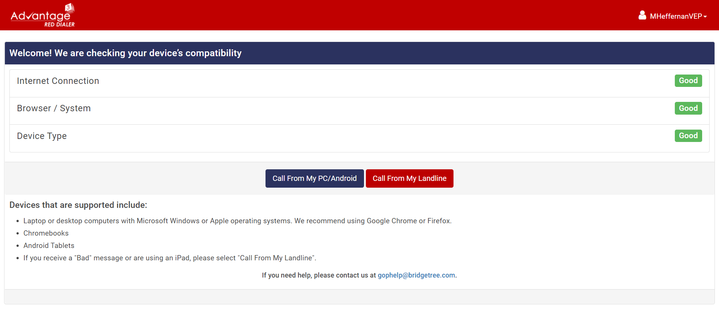
Landing Page after Login

Slide 18
LIVE Callbook in VEP
Callbooks may be more than one. This step you select your callbook based on what we are to use.

Slide 19
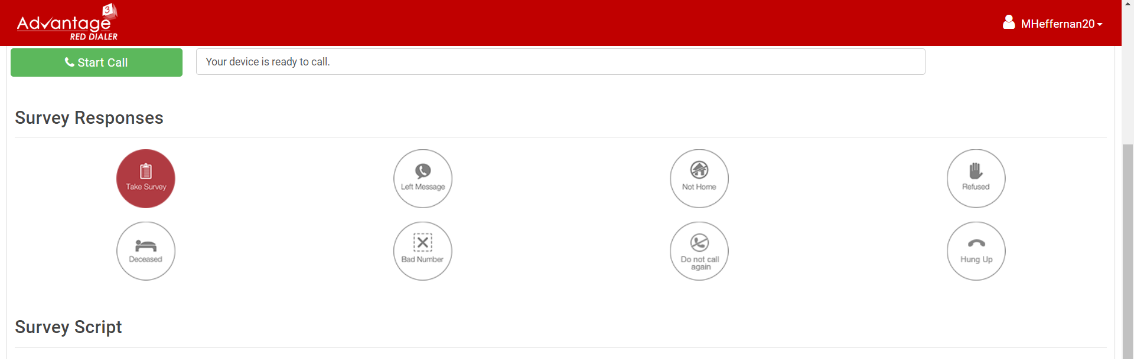
Sample Start Call with Options

Slide 20
Actual Survey Script is viewable when you hit Start call for you to follow

Slide 21
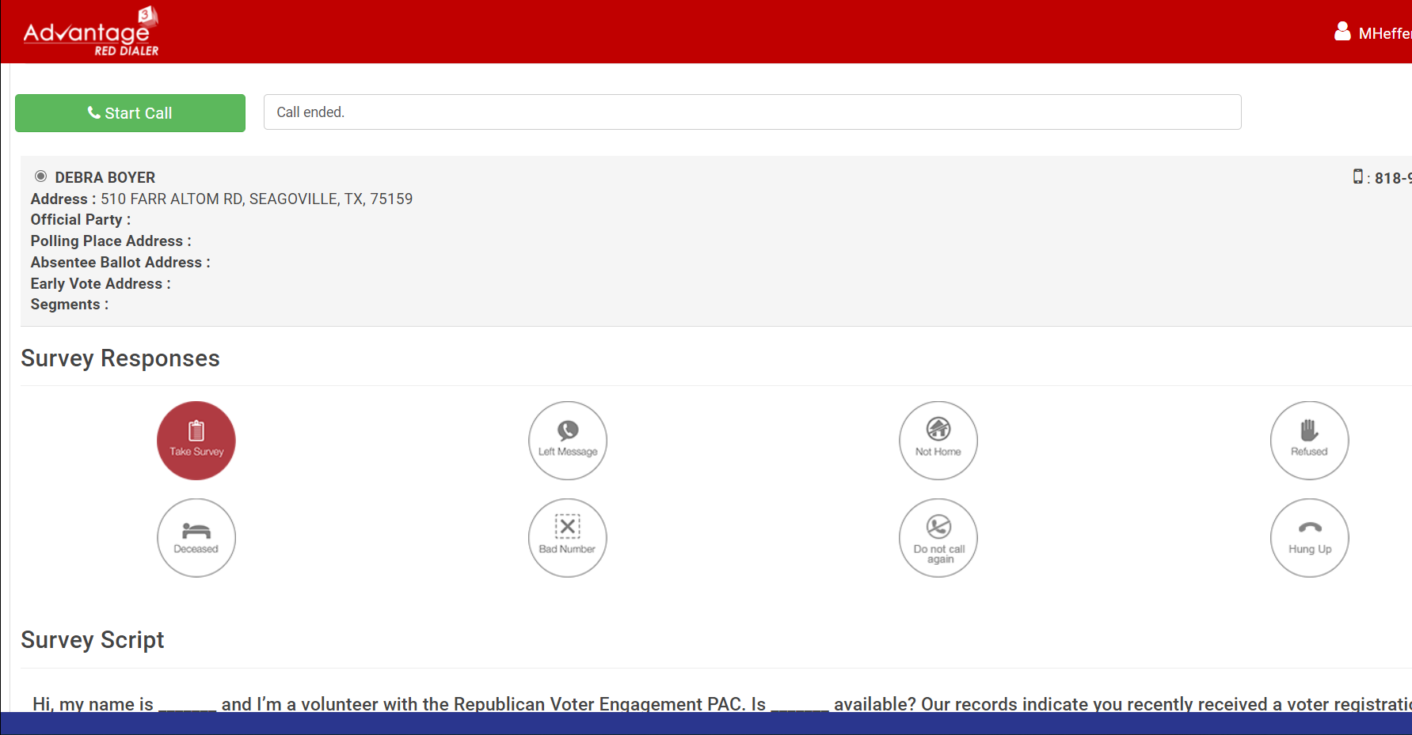
Note ‘Call Ended’ /Survey Taken, Next caller displayed.

Slide 22
LIVE TRAINING
TRAINING WITH VEP Weekly @ Minimum
Your volunteer member information submitted to have credentials setup using the form provided to the Regional Director is sent to: wvarley@txvoterengagement.com and tboschwitz@bridgetree.com
Once setup, you will receive an email with your credentials and invite for training from the CRM Advantage email address.
Reach out to VEP for Training Time/Date and ZOOM invitation if not received.
Note: ZOOM INVITE – link for Zoom or Phone number for call-in for you to connect for the live training. (requires phone or PC)
Regionals should publish regular updates on training, new workbooks and other endeavors to facilitate our project to register future voters.

Slide 23
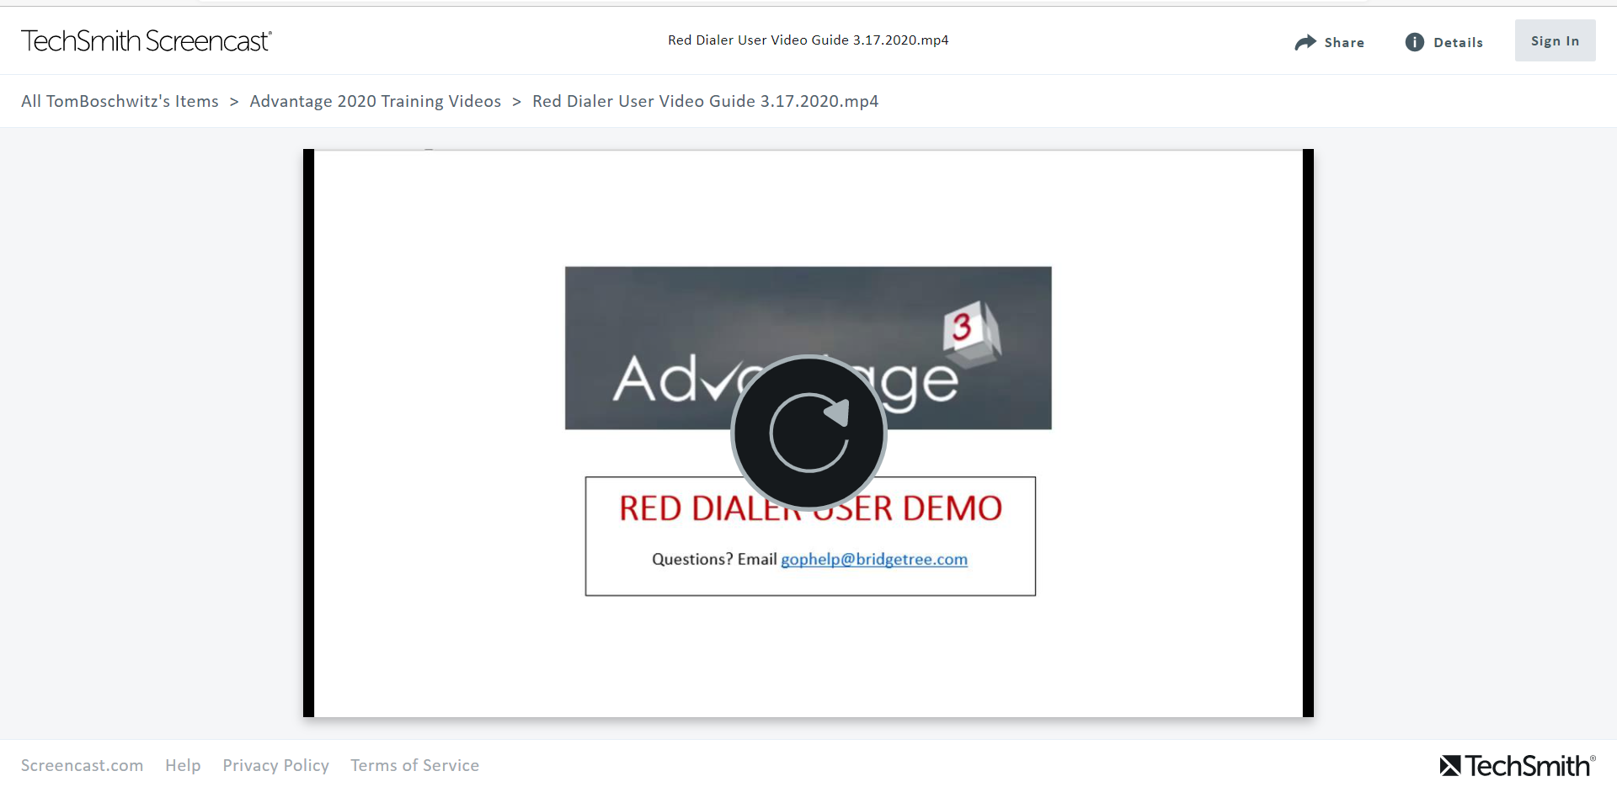
Contacts/Links
Training Video for Reddialer in the TechSmith Screencast tool is : https://www.screencast.com/t/7lXGvFCqc
Help with Reddialer or questions related to your Device Compatibility: gophelp@bridgetree.com
Call for refresher training with your VEP Regional or volunteer contact.

Slide 24
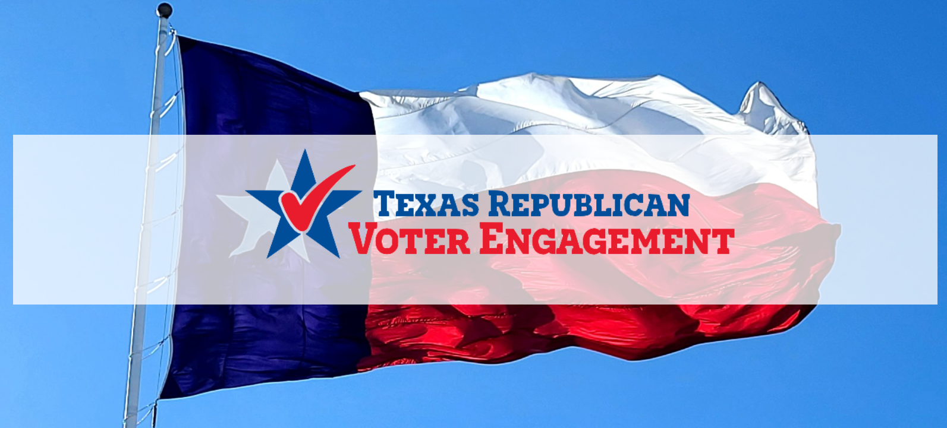
Thank You !
Q and A

